Slide 1



Revisiting Performance Evaluation in the Age of Uncertainty
Pedro Bruel, Viyom Mittal, Dejan Milojicic, Michalis Faloutsos, Eitan Frachtenberg
Hewlett Packard Labs, USA; UC Riverside

Slide 2
Outline
Performance estimation challenges
Pitfalls of performance summaries
Empirical examples
Proposed approach for Educators and Practitioners
Assignment ideas
Conclusion
2

Slide 3
Performance estimation challenges
HPC systems and cloud-native environments:
Layered software abstraction
Multi-level hardware
Interference from other applications
Factors like rack and server room temperature
3

Slide 4
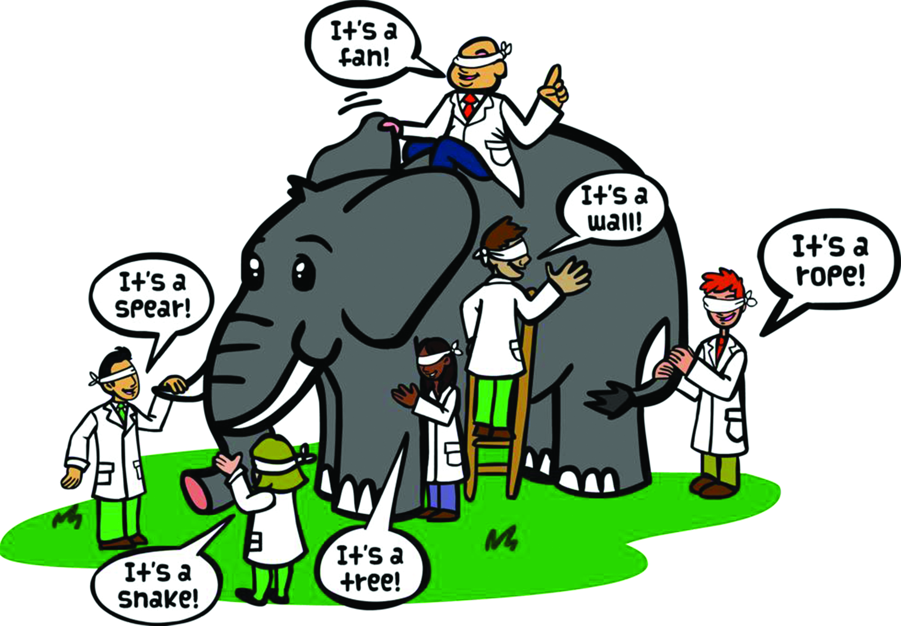
Performance estimation challenges
HPC systems and cloud native environments:
Layered software abstraction
Multi-level hardware
Interference from other applications
Factors like rack and server room temperature
4

Slide 5
Performance estimation challenges
HPC systems and cloud native environments:
Layered software abstraction
Multi-level hardware
Interference from other applications
Factors like rack and server room temperature
Limitations of current approaches:
Incomplete performance descriptors
Insufficient/excessive performance samples
Failure in capturing rich behavioral patterns
5

Slide 6
Performance estimation challenges
HPC systems and cloud native environments:
Layered software abstraction
Multi-level hardware
Interference from other applications
Factors like rack and server room temperature
Limitations of current approaches:
Incomplete performance descriptors
Insufficient/excessive performance samples
Failure in capturing rich behavioral patterns
Proposal for a new approach
Performance as a number => Performance as a distribution
6

Slide 7
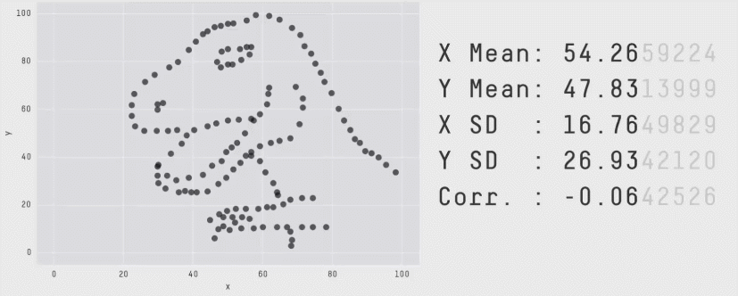
Pitfalls of performance summaries
Wrong summary statistics
7

Slide 8
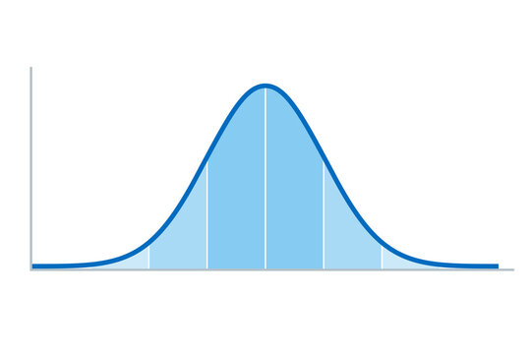

Pitfalls of performance summaries
Wrong summary statistics
Wrong model
confidence interval (CI) around the mean
8

Slide 9
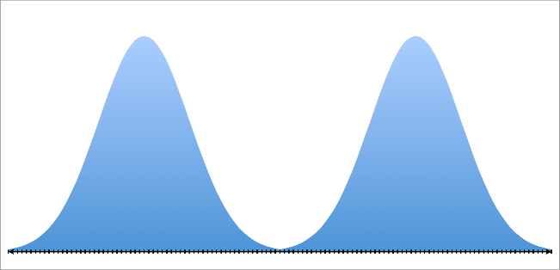

Pitfalls of performance summaries
Wrong summary statistics
Wrong model
confidence interval (CI) around the mean
9

Slide 10
Pitfalls of performance summaries
Wrong summary statistics
Ignoring important outliers
Wrong model
Not enough samples
confidence interval (CI) around the mean
10

Slide 11
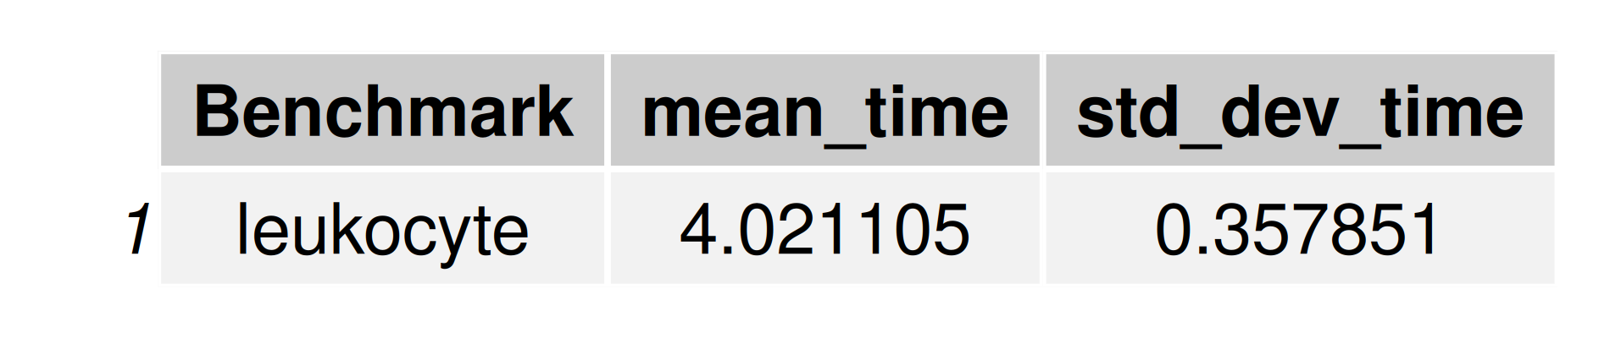
Empirical examples
Similar things can happen with performance measurements:
Summary statistics of 1,000 performance measurements of Leukocyte, an application in the Rodinia benchmark suite
11

Slide 12
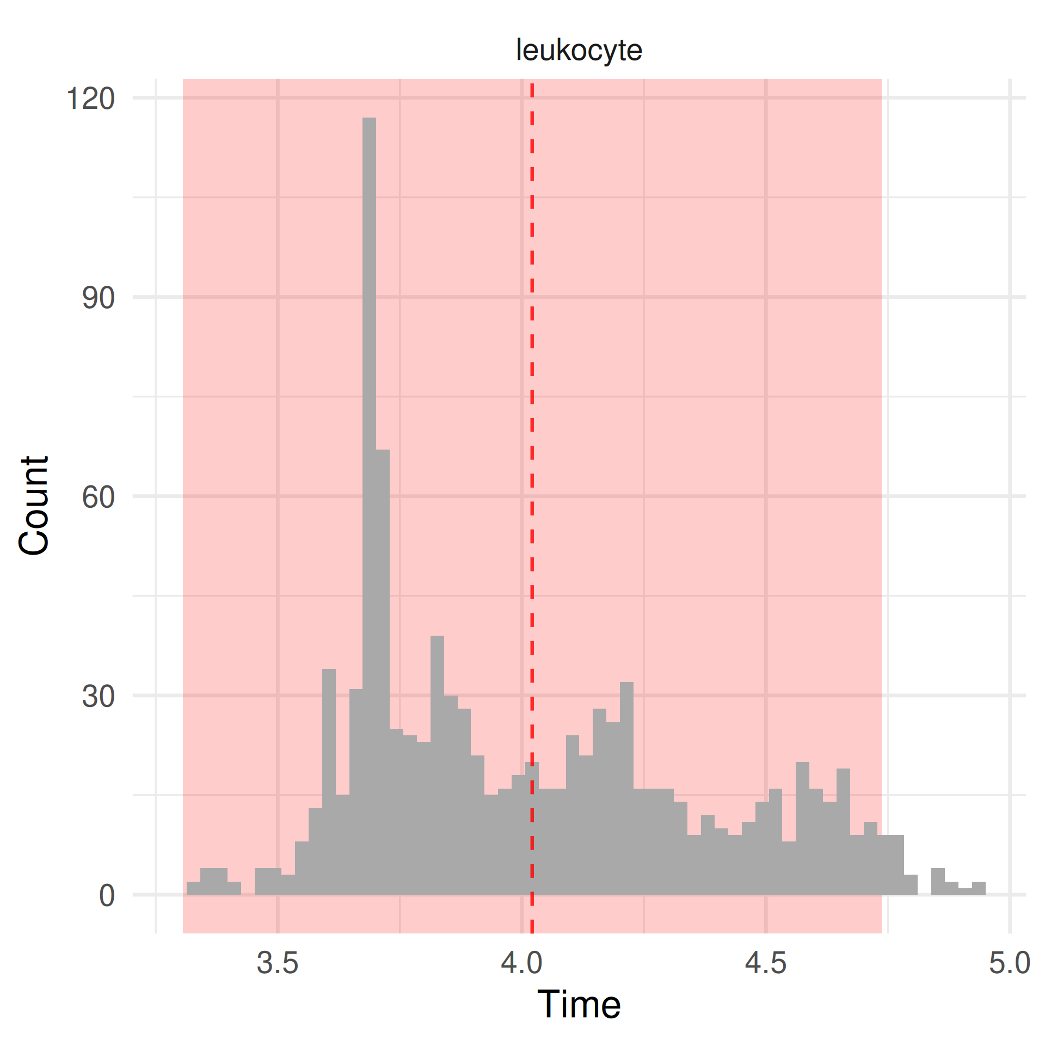
Empirical examples
Similar things can happen with performance measurements:
Summary statistics of 1,000 performance measurements of Leukocyte, an application in the Rodinia benchmark suite
12

Slide 13
Empirical examples
Similar things can happen with performance measurements:
Summary statistics of 1,000 performance measurements of Leukocyte, an application in the Rodinia benchmark suite
Questions we can ask after looking at the distribution:
How many modes can we identify?
What causes each mode?
What causes the outliers?
What does the mean mean?
How many measurements do we need to accurately represent the performance of this application?
13

Slide 14
Proposed approach for Educators and Practitioners
Shifting perspective: Performance as a Distribution
Embrace exceptions
Measure enough samples
Report
Distributions
Measure just enough samples
Expect
Distributions
Embrace statistics
14

Slide 15
Assignment ideas
Applying the new approach
Benchmarks: Rodinia, StressNG, TPC and many others
Beginner
Intermediate
Expert
Answer questions like:
What can you say about the performance of each application in the benchmark suite?
How many repeated measurements did you make of each application?
Why did you choose this number of repetitions?
What is the best way to represent your inferences?
The measurements should be done with different
levels of interference from other applications and stressors. The students can try to:
Run a benchmark with and without interference from another program
Eliminate as much interference as possible
The students can run and compare the performance distributions for applications on the suite using different programming models and libraries such as OpenMP, MPI, and CUDA and provide detailed analysis.
15

Slide 16
Conclusion
Performance summaries can be hard to estimate accurately and can obscure critical insights about the system under test.
Requirement for a shift from treating performance as a number to performance as a distribution.
Need of utilizing better statistical tools to evaluate and compare performance distributions.
Propose several practices and concepts to be taught to HPC students and practitioners, so that they may produce rich and accurate performance evaluations.
Future scope and ongoing work
Areas to address: Autostopping, predicting variability and reproducibility
SHARP (To be open-sourced soon)
16

Slide 17

Thank you for your attention
Any Questions
17

