Slide 1
Estimating energy-efficiency in quantum optimization algorithms
Rolando Pablo Hong Enriquez‡, Research Scientist
RM Badia*, B Chapman†, K Bresniker‡, A Dhakal‡, E Frachtenberg‡, G Rattihalli‡, N Hogade‡, P Bruel‡, A Mishra‡, D Milojicic‡
†Hewlett Packard Enterprise, ‡Hewlett Packard Labs, * Barcelona Super-Computer Center
May 11, 2022

Slide 2
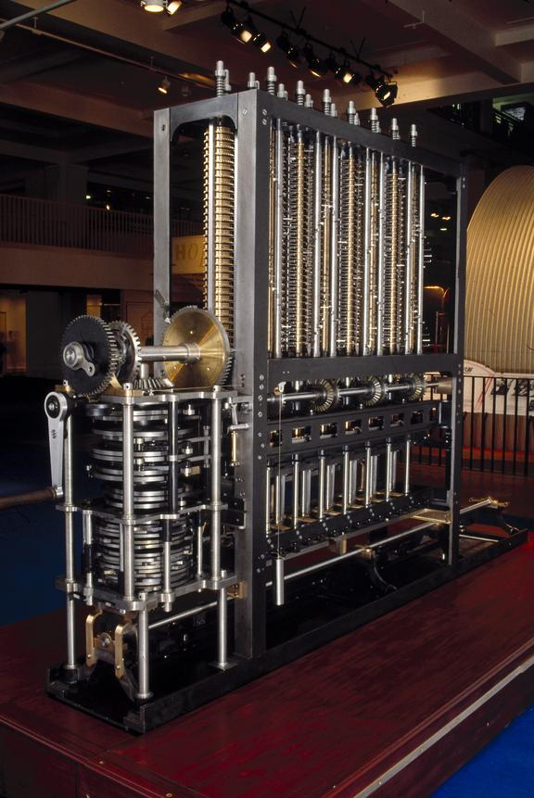
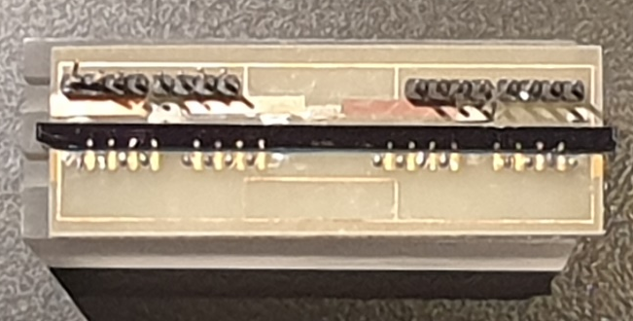
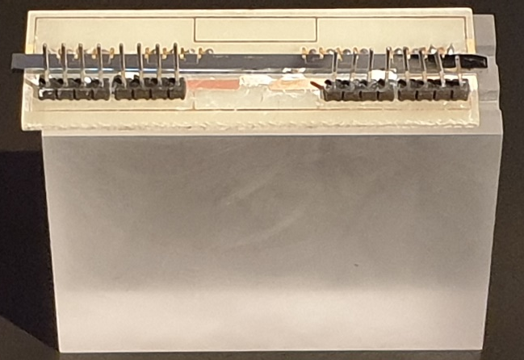
Last minute fun fact
Babbage Difference Engine 2 (1847-1849)
QC Chip – Bristol Univ. (2012)

Slide 3
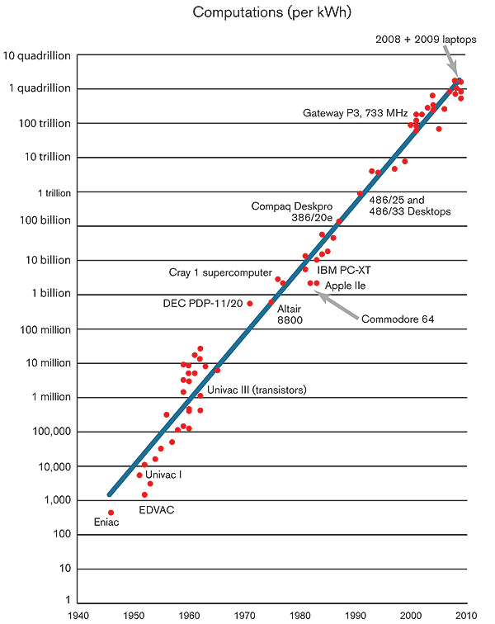
Motivation
Superconducting qubits
Trapped ions
Quantum dots
Topological qubits
Rydberg atoms
Photonic qubits
Diamond vacancies
Silicon-based computing
Quantum Computing Technologies
https://www.technologyreview.com/2012/04/09/186841/the-computing-trend-that-will-change-everything/

Slide 4
Motivation
Quantum algorithms
Quantum Information techniques
Amplitude amplification
Quantum Fourier
Quantum walks
Applications
Mathematical application
Quantum simulations
Machine Learning
Etc.
Etc.
QC Architecture
QC technology?
Quantum annealers
Gate-Based QCs
Superconducting
Photonic
Topological
Etc.
In this work:
Theoretical understanding (Quantum Circuit evaluations)
Quantum Optimization
Proxy estimations for Energy consumption
https://www.technologyreview.com/2012/04/09/186841/the-computing-trend-that-will-change-everything/

Slide 5
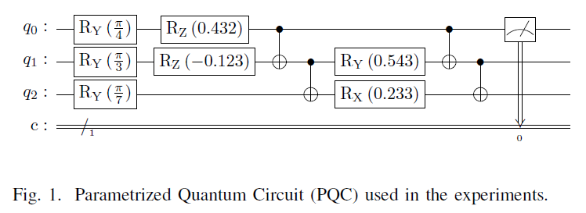
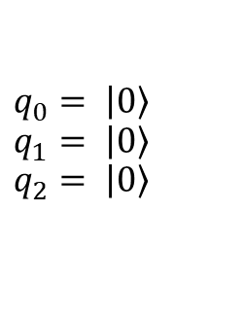
Quantum operations & Quantum circuits
Two-qubit gate
measurement
Single-qubit gate
Qubit
Input. For instance:
$$q_{0}= \left|\left.0\right\rangle \right.$$
$$q_{1}= \left|\left.0\right\rangle \right.$$
$$q_{2}= \left|\left.0\right\rangle \right.$$
Time
Classical bit

Slide 6
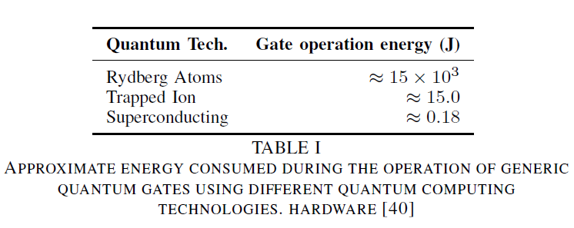
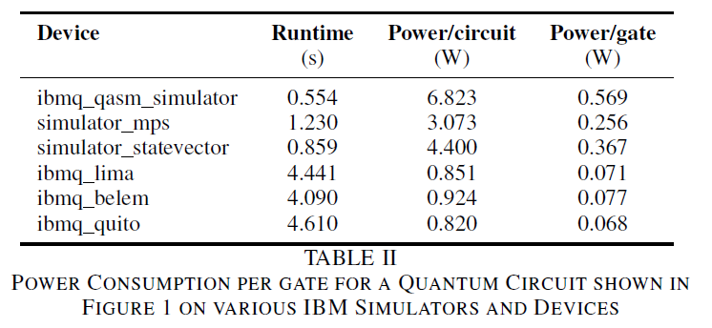
Energy consumed in quantum operations

Slide 7
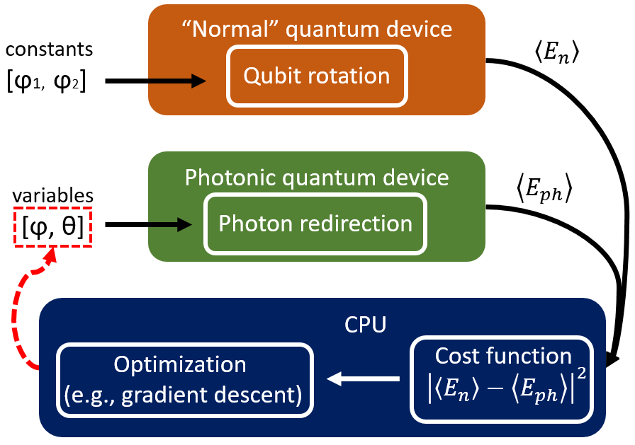
Factors affecting the energy-efficiency of quantum optimization algorithms
Workload distribution between classic/quantum devices.
Other factors
Classic/Quantum partition
Number of circuit evaluations per algorithm.
Evaluations per gate type
Energy consumption per gate type
Number of shots per circuit
Types of gates
Number of qubits
Classic energy consumption

Slide 8
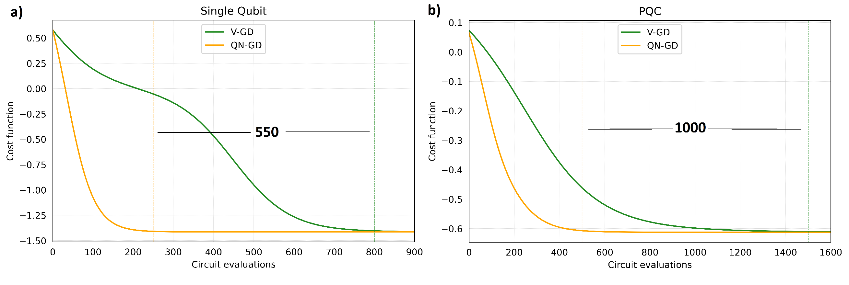
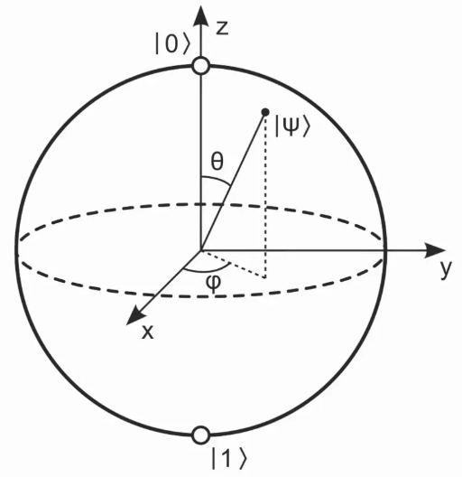






Quantum Natural Gradient Descent (QN-GD)
$$100 J \left(\sim 0.3kW\right)$$
$$3.7×{10}^{3} J \left(\sim 6.8kW\right)$$
$$3.1×$$
$$3×$$
QN-GD
V-GD

Slide 9
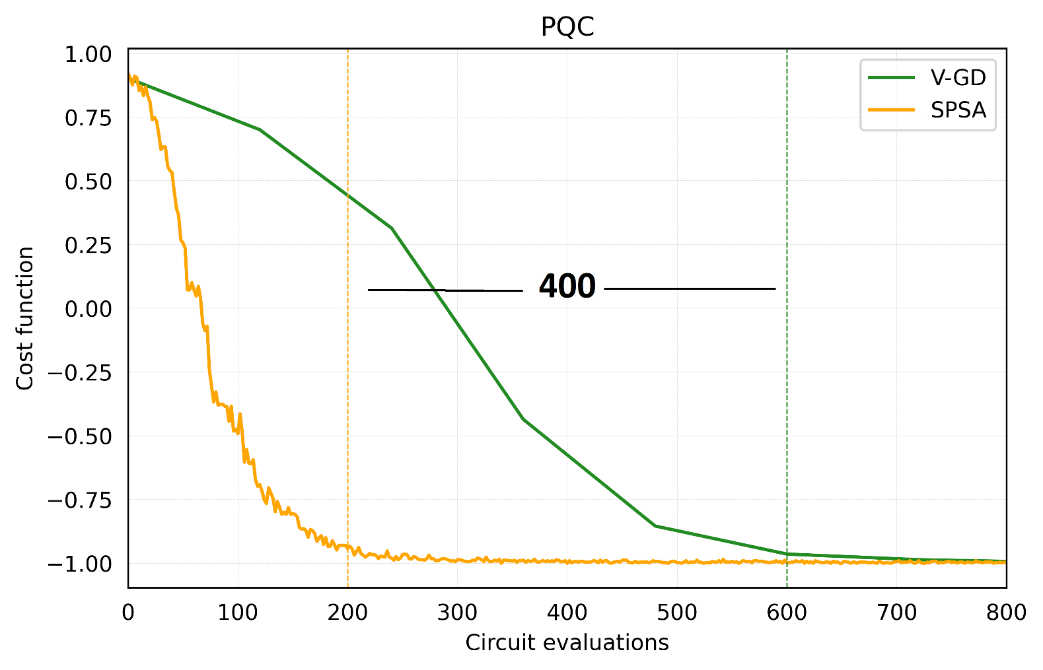

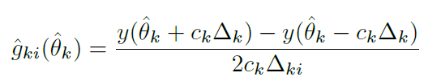





Simultaneous Perturbation Stochastic Approximation (SPSA)
$$5.7×{10}^{3} J \left(\sim 17.9kW\right)$$
$$3×$$
$N_{gates}=N_{trainable}+N_{non−trainable}$
$=60+20=80$
SPSA
V-GD

Slide 10
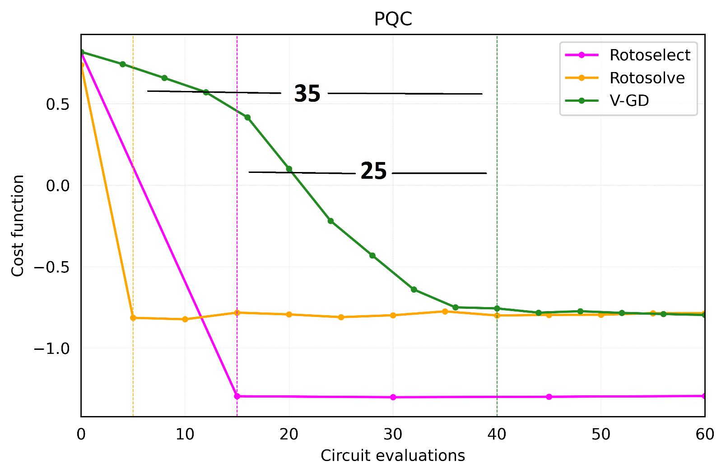







Quantum Circuit Learning (rotosolve/rotoselect)
$$12 J \left(\sim 40W\right)$$
$$9 J \left(\sim 28W\right)$$
$$\sim 2.6×$$
$N_{gates}=N_{trainable}+N_{non−trainable}$
$=2+0=2$

Slide 11
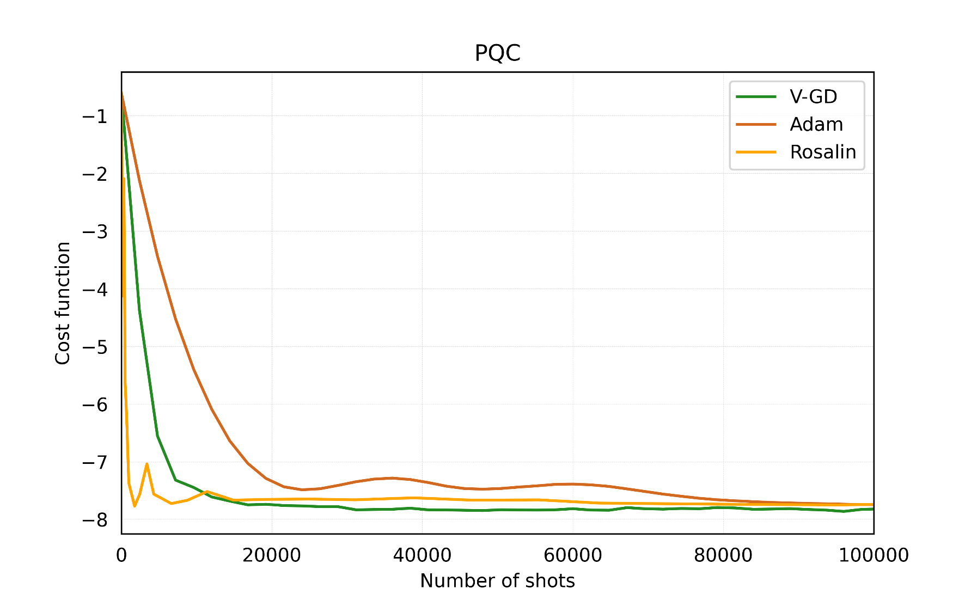
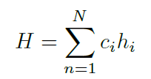

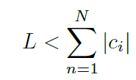
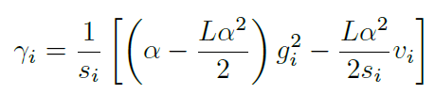



Frugal shot optimization (Rosalin)
$$18 J \left(\sim 56W\right) −per optimization step$$
$$\sim 20×$$
$N_{gates}=N_{trainable}+N_{non−trainable}$
$=2+0=2$

Slide 12
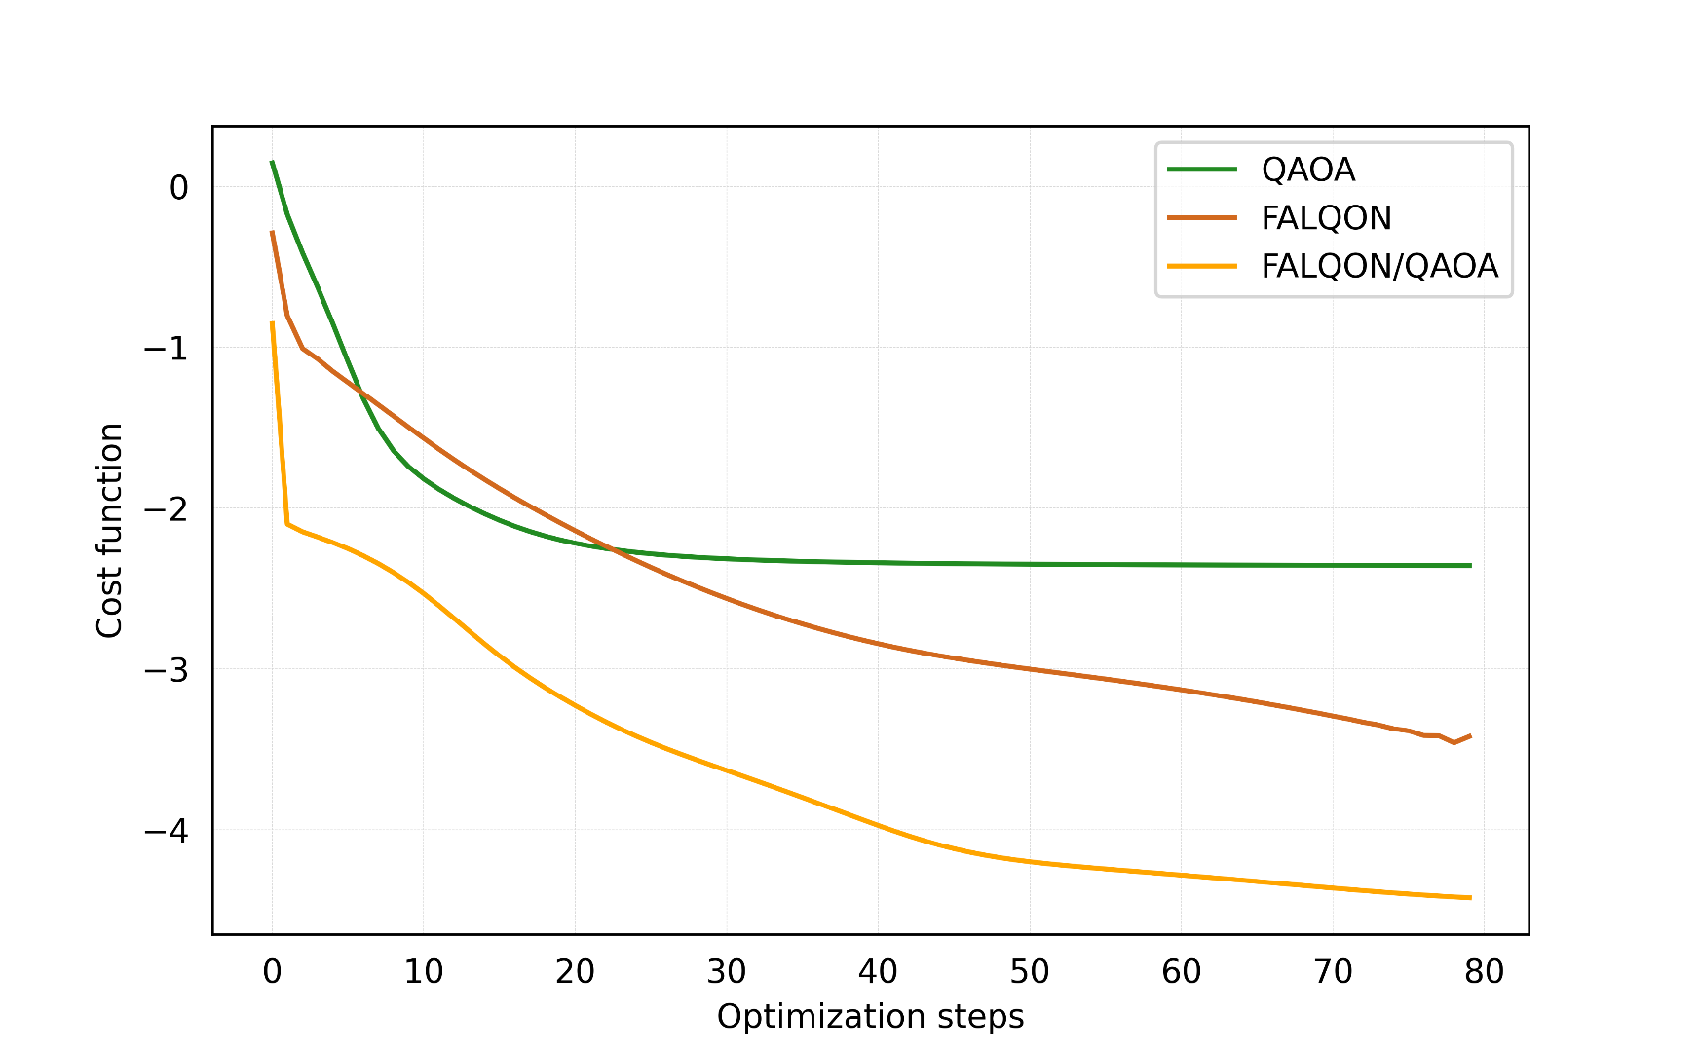


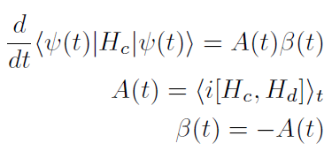

Combinatorial optimization (FALQON/QAOA)

Slide 13
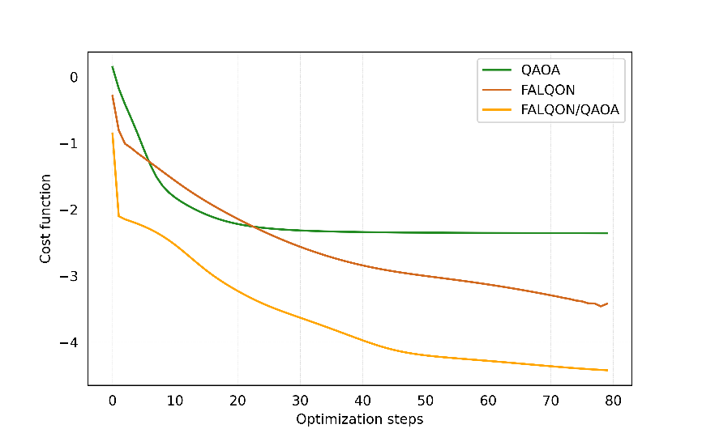

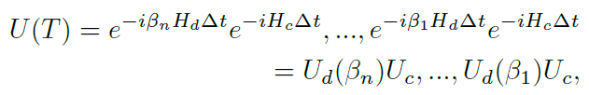








Combinatorial optimization (FALQON/QAOA)
FALQON
$$N_{gates}=25$$
$$N_{steps}=5$$
$$45 kJ \left(\sim 140W\right)$$
QAOA
$$22.5 kJ \left(\sim 70W\right)$$

Slide 14
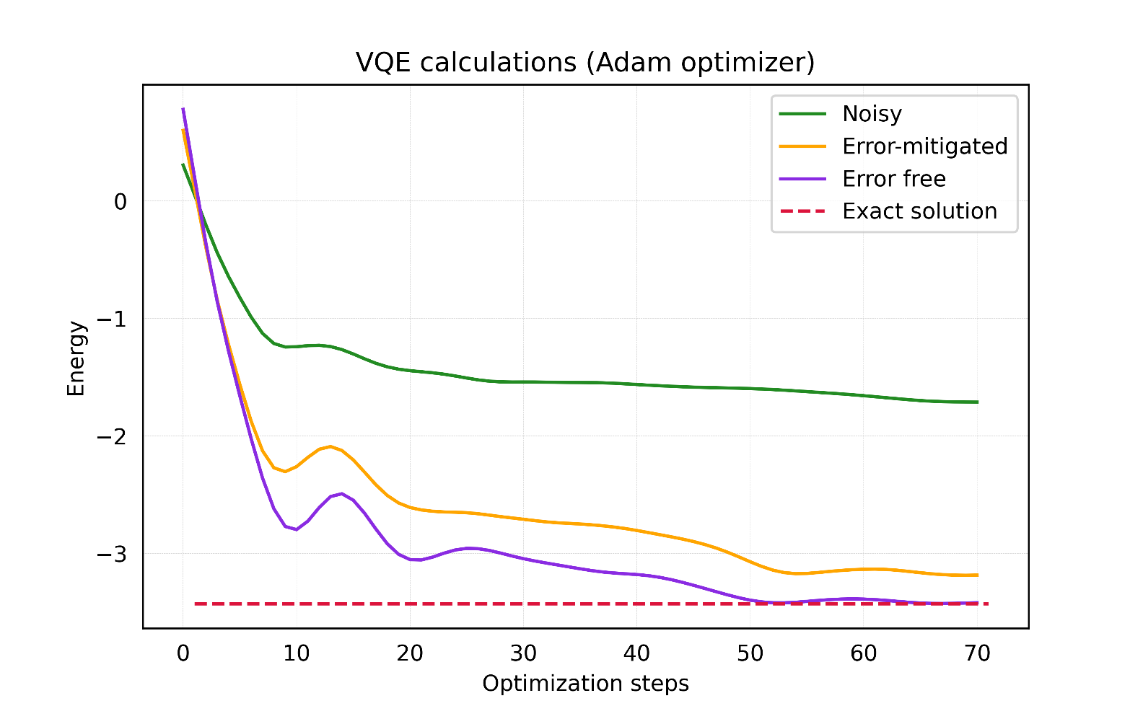



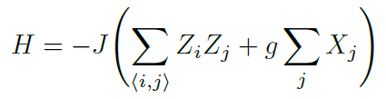
Differentiable Quantum Transforms (ZNE)

Slide 15
Interesting algorithms not studied here
Quantum Analytic Descent
Multivariate quantum gates
Barren plateaus
Approximate fast classic models of the quantum landscape
Complex and more expressive quantum gates for variational optimization problems.
Techniques to increase the probability to find good solutions in the landscape of Hilbert spaces.
Etc.

Slide 16
Conclusions
Algorithm theory
An understanding of the theoretical basis of quantum optimization is a valuable tool to estimate the energy efficiency of these calculations.
Energy-advantages
Some algorithms studied here like QN-GD, SPSA or circuit learning techniques can boost energy efficiency in the range of 2x-4x.
Radically innovative algorithms such as Rosalin (frugal shot optimization) can easily boost energy efficiency beyond 20x.
Algorithms like FALQON can be executed without classical hardware and outperform their hybrid classic/quantum counterparts (QAOA). However in its present form FALQON implementations might become energy-inefficient if good solutions are not found rapidly.
The energy efficiency of error-mitigation techniques as well as other recent algorithms needs to be further investigated.

Slide 17
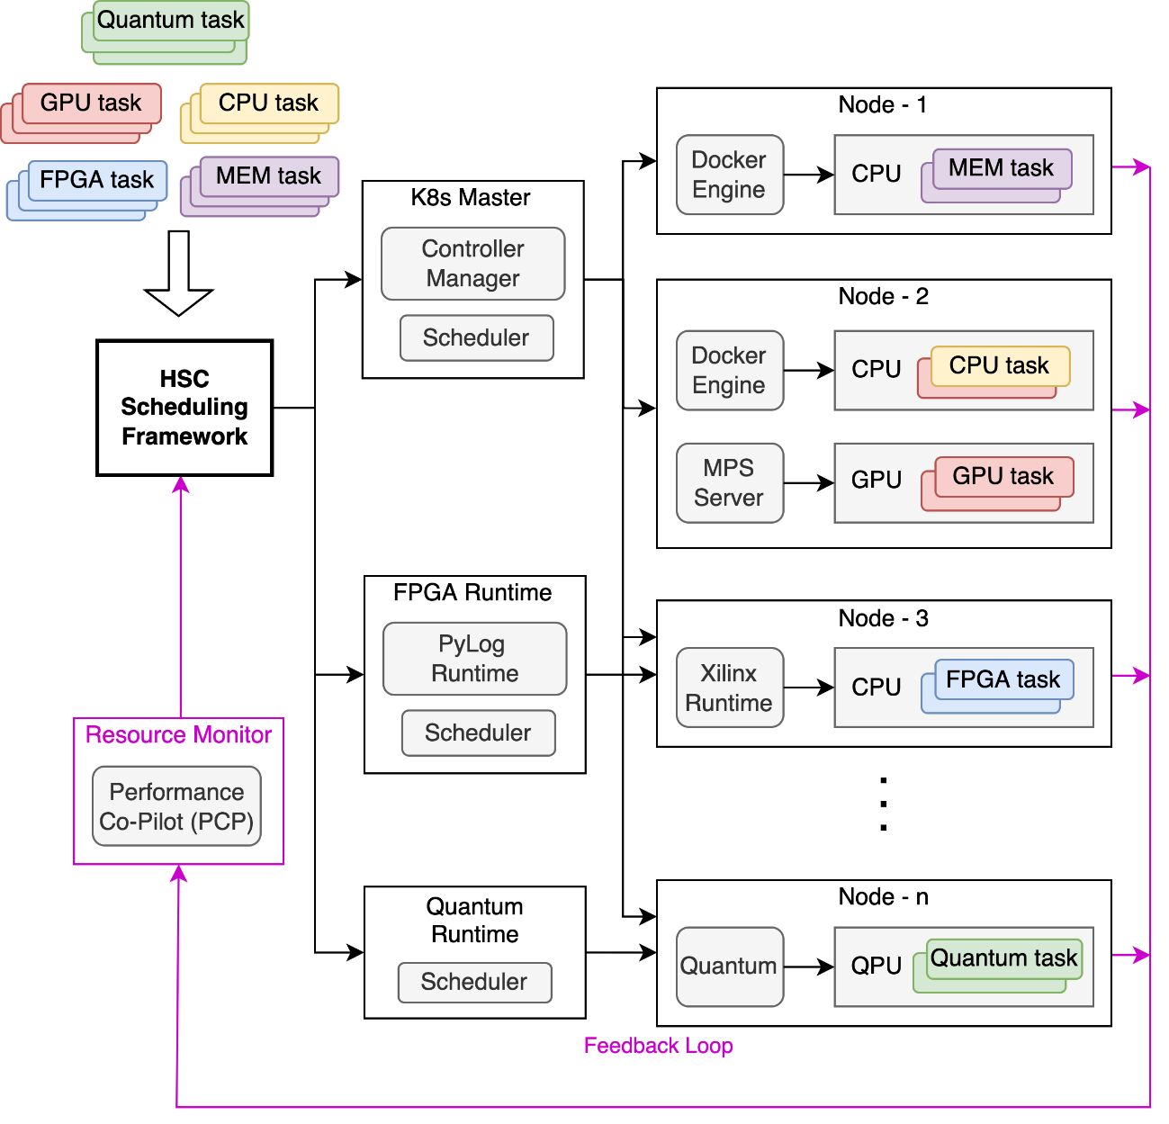



Context: Heterogeneous Serverless Computing (HSC)
end user
workflows
functions
apps
models
HSC workflow
manager(s)
HSC DevOps
HSC platform
tools
sustainability
dashboard
HSC benchmark
framework
energy-aware scheduler
(de)composition
program-4-heterog
serverless runtimes
developer
auto
bench
operator
app. performance prediction
accelerator management
on-prem
cirrus
green lake
public cloud
CPU GPU FPGA TPU DPU QPU
deployment

Slide 18
Thank you
Rolando Pablo Hong Enriquez
Research Scientist. Hewlett Packard Labs
rhong@hpe.com
RM Badia*, B Chapman†, K Bresniker‡, A Dhakal‡, E Frachtenberg‡, G Rattihalli‡, N Hogade‡, P Bruel‡, A Mishra‡, D Milojicic‡
†Hewlett Packard Enterprise, ‡Hewlett Packard Labs, * Barcelona Super-Computer Center

