Slide 1



Building a High-performance Key-value Cache as an Energy-efficient Appliance
Song Jiang
Yuehai Xu
Eitan Frachtenberg
Facebook, Inc.
Notes:
a KV cache in the kernel as an energy-efficient appliance

Slide 2
Key-value (KV) Cache Becomes Critical
A large-scale memory pool serving as a cache to support performance-demanding applications.
A performance-critical infrastructure receiving requests (GET/SET/DELETE) and sending replies over the network.
Example: Memcached at Facebook deployed on very large number of servers supplying many terabytes of memory.
Unquestionably being memory-intensive and network-intensive.
But is it also CPU-intensive with its hash table operations?
Notes:
A key-value cache in a data center is usually presented as .. that temporally store their data in the form of key-value items, often access them with a high request rate and demands high throughput and low latency.
It has been a performance-critical infrastructure component directly related to front-end applications’ service quality and user experience.
Memcached uses hash table to organize the KV items. Intuitively, only minimal computation, or a minimum number of CPU cycles, should be required to
look up and possibly modify a hash table datum. If this is the case, a low-power processor with a few cores, combined with large DRAM memory, could suffice to service a heavy request load with low latency. As such, the acquisition and energy cost of KV-cache servers could be significantly lower than that of a general-purpose cluster, making the KV caching a cost and energy efficient service.

Slide 3
Outline
Investigation of problem:
    Is Memcached CPU-bound?
Exploration of solution:
    Would targeted optimization(s) on network stack help?
The Hippos approach:
    skip the network processing rather than attack it!
Evaluation of Hippos:
    with both micro-benchmark and production workload
Conclusions of the work:
    Building in-kernel appliance can be a viable and promising solution.

Slide 4
Investigation: Is Memcached CPU-bound?
The workload
  Streams of 64-byte UDP GET requests from 32 clients
  Representative of Facebook’s workload characteristics
    Small KV size
    High ratio of GET to SET
    Spikes of request rate
The server
  Intel 8-core Xeon processor
  64GB memory
  1Gbps NIC
Notes:
We set up a platform to investigate whether Memcached is CPU demanding and how the CPU cycles are spent.

Slide 5

Schemes for the Investigation
Stock Memcached:
  Hash table and LRU data structure protected by locks
  Multiple threads listening on one UDP socket protected by a lock
Multiport Memcached
  Disable the locks for hash table due to use of all-GET workload
  Remove LRU lock by using CLOCK replacement
  Remove UDP lock by having one thread per UDP port
Memcached
Hashtable + LRU
HashTable + CLOCK
Memcached threads
UDP socket queue
Network routines
The Kernel
Notes:
we also made efforts within the application to minimize the chance for Memcached to be a CPU-demanding one. Multiport memcached represents an optimistic case for the purpose of this investigation.

Slide 6
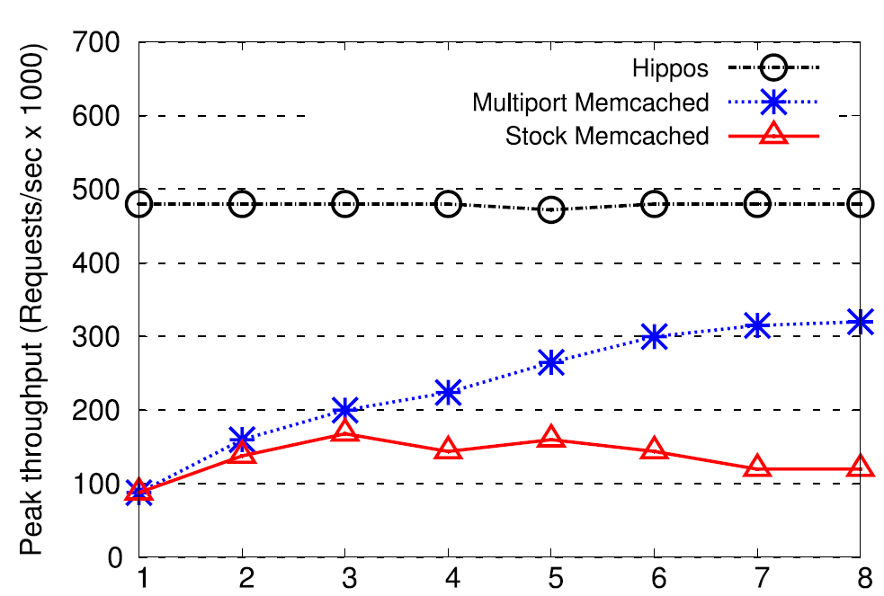
Computation Power is Demanded
# of Cores
Notes:
peak throughput is reported as the highest throughput observed while the corresponding mean request latency is kept under 1 ms.
When the core count increases from one to three, both Stock Memcached and Multiport Memcached increase their throughput. This suggests that Memcached’s performance is probably constrained by the CPU; in other words, Memcached requires more CPU
cores to unlock its performance potential. When the CPU core count increases beyond three, Stock Memcached’s throughput begins to plateau and even drops off due to lock contention within the kernel network stack. In contrast, with multiple sockets Multiport Memcached sees its throughput still climbing, albeit at a slower rate. This may also demonstrate that the demand on CPU cores does not saturate 1 Gbps network card even with all eight cores enabled.

Slide 7
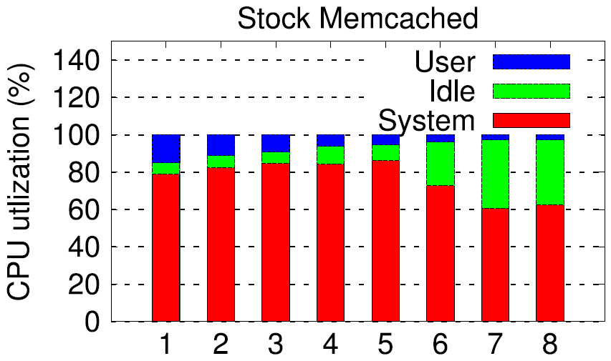
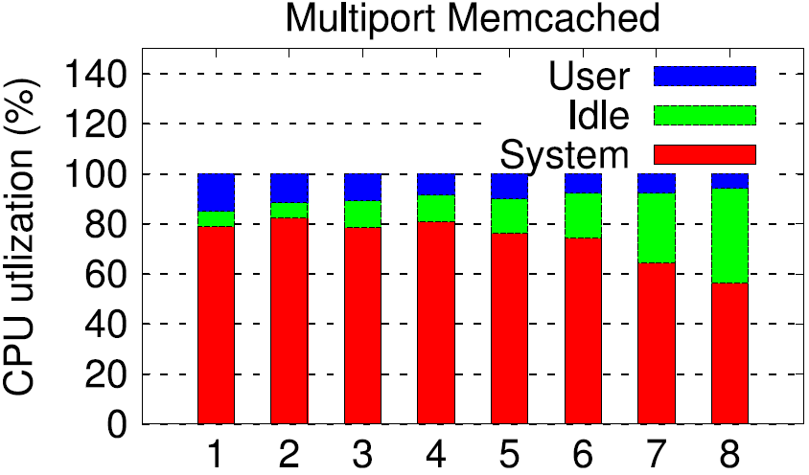
Who Needs the Cycles?
# of Cores
# of Cores
The result: A CPU-demanding application
Notes:
percentages of the CPU cycles that are spent in user-level or kernel-level (system) functions, or when the CPU is idle. most of CPU time is spent in the kernel
Accompanied with the reduction of user time is the increase of idle time.
This time is mostly spent on the Linux network stack. In Linux, a spinlock is used for exclusive access of the socket buffer queue(s). Memcached contends heavily for the lock, resulting in wasted CPU cycles.
Considering the percentages of CPU times used in both user and system levels, Memcached turns out to be a CPU demanding application. As such, a KV cache can have increased request latency and limited peak throughput if the CPU is not sufficiently powerful.
If we have to use powerful CPU, cost and energy are not efficient.

Slide 8
Exploration of Solution: Where are CPU Cycles Spent?
Memcached
Routine Description | CPU Consumption
Receive/transmit, event-handler functions in Memcached and libevent | 8.26%
Memory copy between kernel and user levels; system calls and polling system routines; | 7.98%
Socket layer: receive/transmit functions | 7.66%
UDP layer: receive/transmit functions | 7.75%
IP layer: receive/transmit functions; connection tracking, filtering and routing | 11.64%
ETH and driver layer: RPS, e1000e, and receive/transmit functions | 15.42%
Memory subsystem: skb/slab functions | 23.32%
Scheduling, softirq, timers, and other routines as well as overheads from Oprofile | 17.21%
{
USER
libevent
KERNEL
Socket layer
TCP/UDP layer
IP layer
ETH & Device Driver
Notes:
We use oprofile to profile the running of multiport Memcached and see where these cycles are spent in particular across numerous functions in the user- and kernel-level functions. Distribution of the CPU cycles among eight categories of 289 functions, which span all networking layers of the system
The user level, which includes routines in Memcached and its library libevent, consumes only 8.26%.
The memory copy between kernel and user space, as well as system calls and polling staffs in the kernel consume only 7.98%, indicating that even the in-kernel implementation that relies on kernel socket is not enough, at least for memory-based KV cache, like Memcached, as we can see that they can only eliminate these two kinds of overheads, which are around only 16%.
Among the function categories, memory subsystem has the highest percentage, mainly because of the frequent operations on slab allocator system and skb, the main data structure that manages data packet in Linux network stack. However, these operations are actually distributed all the layers, none of them stands out specifically in any certain layer.
The CPU time is distributed more or less evenly across the user layer, SOCKET layer, UDP layer, IP layer, and ETH and device driver layers. This flat profile defeats any cost-effective attempts to pinpoint specific functions or layers to optimize.

Slide 9
Does Optimizating Network Stack Help?
Elimination of lock contentions in Memcached and on UDP socket buffer queue [Nishtala NSDI’13]
Optimizing packets handling
  Distributing packets among CPU cores
  Reducing number of packets by using jumbo frames
  Mitigating interrupts
Rewriting the whole network stack
  IsoStack: separating cores for supporting the network stack from running applications [Shalev USENIX ATC’10]
Exposing the low level packet data to user space directly,
  Netmap [Rizzo, USENIX ATC’12]
  Netslice [Marian Cornell University, 2010]
Notes:
efficient parallelization of the stack remains difficult due to overhead from synchronization, cache pollution, and scheduling in the layers of the network stack in a multicore system
However, Memcached does not consume many CPU cycles for its own, as shown in
Table 1, and could hardly benefit from this technique
However, it can be hard for a general purpose application like Memcached to take advantage of this capability and retain compatibility with clients.

Slide 10
The Hippos Approach:
Moving the KV Cache to the Kernel
Objectives for selection of hosting position:
Reduce most overheads of the network stack
Least intrusive to the current network stack architecture
Potential:
  Many network layers can be bypassed and their associated cost can be eliminated
Feasibility:
  KV cache is hosted on dedicated servers providing service to internal applications
  Less concerns on system security and usability
KV Cache
at the User Level
?
Network Stack in the Kernel
Socket Layer
TCP/UDP Layer
IP Layer
ETH and Device Driver
Notes:
Moving the KV Cache Closer to NIC
The method is to move it into the kernel in a position close to the NIC, so that it can directly take IP packets for the KV cache and process them in situ. this approach can remove most time-consuming network operations out of the KV-cache’s critical processing path, including the overhead for system calls, event notifications (via libevent), socket locks, and most of the overheads in the UDP and IP layers are eliminated.
Minimal or no change to the network framework
It should not affect the use of networking by other applications
It typically runs in a controlled environment (e.g., data centers) and its sole purpose is to provide caching service to other application servers.

Slide 11
Locating a Place to Hook Hippos in
Memcached
Position | Method to intercept Packet
4. Received by Memcached | Process in Memcached without replying
3. Leaving UDP socket queue | Reading requests without sending them to user level
2. Entering UDP socket queue | Open the socket without reading requests
1. Reaching IP layer | via Netfilter hook NF_INET_PRE _ROUTING
USER
libevent
KERNEL
Socket layer
TCP/UDP layer
IP layer
ETH & Device Driver
Notes:
In order to find out the right place to hook the implementation in, we setup 4 observation points on the receiving path to evaluate the latency for the traffic to reach these positions and CPU overhead. The workload is the same as that used in the previous experiment. Quickly go through these positions

Slide 12
Latency Observed at the Positions
Memcached
4. Received by
Memcached
USER
libevent
KERNEL
3. Leaving UDP
socket queue
Socket layer
2. Entering UDP
socket queue
TCP/UDP layer
IP layer
1. Reaching IP layer
ETH & Device Driver
Notes:
As we can see that position one and two performs pretty well, the latency doesn’t change even under heavy request load. CPU also stays almost idle in these two positions. While at the position 3, the latency becomes to increase when the request load grows. Finally, the fourth position shows the greatest overheads. This observation indicates that position one and two is the best place to locate the KV store.

Slide 13
CPU Utilization Corresponding to the Positions
Notes:
As these plots show, at position 1 and 2, the CPUs are almost idle even when the arrival rate reaches 800 K/second. However, at position 3, the CPU is saturated when the rate is 800K/second. This is mainly because of bottlenecks in UDP socket buffer queue, in which data are placed in and retrieved out by different kernel routines and threads.

Slide 14
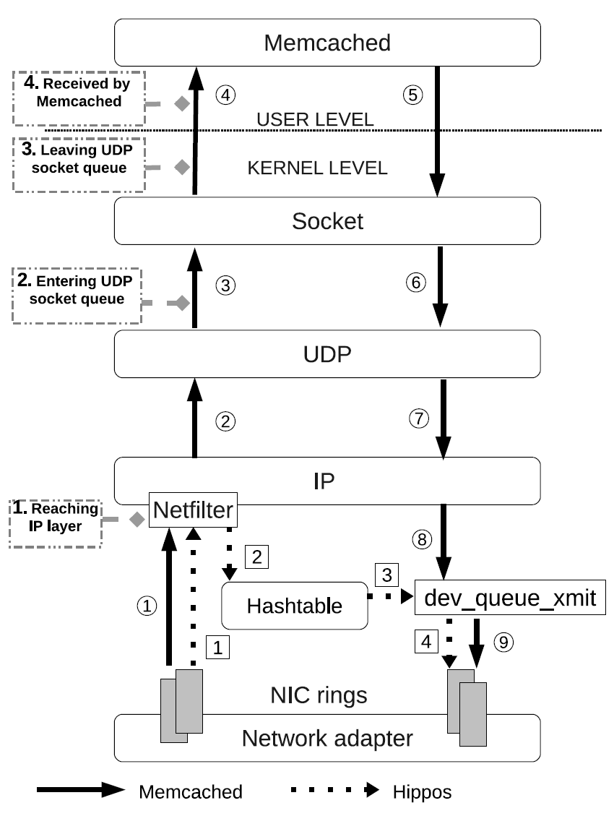
Hippos’ Position in the Network Stack
KV Cache
KV Cache
Notes:
We choose the first position to implement Hippos as it can leverage the netfilter framework to obtain packets without any modification of the operating system. By using the hooks provided by netfilter, Hippos can significantly reduce the UDP packets processing path.
all the information needed for the KV cache is available, such as operation type, number of keys, key contents, or values.

Slide 15
The Logic of Hippos
Is SET?
Y
Unpack packet
Slab Allocator
TCP listening threads
Obtain
<KV>
TCP Layer
Obtain key,
and remove
<KV>
N
Reply to client
Store <KV>
IP Layer
Hippos’ Hashtable
TCP (SET/DELETE)
Obtain key
Retrieve <KV>
Netfilter
Unpack packet
Reuse
SKB?
SKB Allocator
UDP (GET)
N
Y
ETH and Device Driver
dev_queue_xmit
Set SKB addresses
Reply to client
Copy KV to SKB
Notes:
Hippos uses the NF_INET_PRE_ROUTING hook. Although packets received from the hook are still at the IP layer, all the information needed for the KV cache is available, such as operation type, number of keys, key contents, or values. After receiving a packet, Hippos will first check it to see whether it is a UDP GET packet, and if so, whether its destination port is the one defined by the KV cache. If a packet does not satisfy both conditions, Hippos will return NF_ACCEPT in its hook function to allow the packet to resume its journey in the network stack towards the upper layers, such as UDP layer. Otherwise, Hippos retrieves the request from the packet and feeds it into the in-kernel KV cache for processing similar as that in Memcached. The query result will be sent in a packet directly from the IP layer (via function dev_queue_xmit()). If the key or value cannot be held in one UDP packet, a number of UDP packets will be created
and sequence numbers are placed in them, as what is done in Memcached.
Hippos uses the in-kernel TCP socket to receive SET, REPLACE, DELETE, and other writing requests. However, it does not optimize its reception and processing of TCP packets except that it handles them in the kernel. This relieves us from re-implementing
the complex TCP stack.

Slide 16
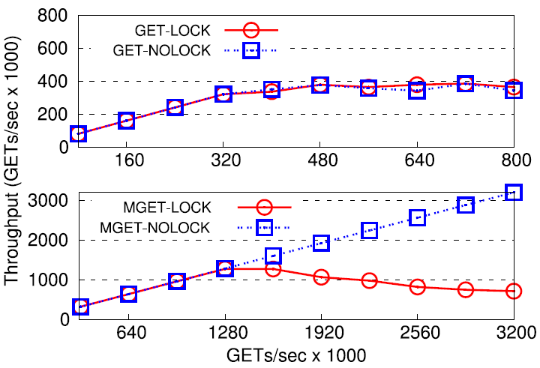
Performance Bottleneck is shifting
Hippos’ approach to the second bottleneck:
RCU (Read-Copy-Update) lock on hash table
No use of lock for CLOCK replacement
Notes:
If the packet processing in the network stack is not the bottleneck, what is the effect of the lock-related cost on Memcached’s performance?
GET+no-existent keys ➔ NOLOCK
As shown in the upper graph of Fig. 6, after we enabled the locks at the increasing packet arrival rate the system achieves the same throughput as that for its counterpart with Memcached internal locks disabled. In other words, the lock overhead is overshadowed by the network cost and thus is not a performance issue unless the network cost is sufficiently reduced.
we need to increase the number of GETs without increasing network cost. To this end, we placed multiple GETs in a UDP packet and kept packet arrival rate constant at 320 K packets per second.
RCU allows readers to access the shared data without any conventional lock. For
writes, it creates new copies to accommodate updates before old copies are freed. In RCU, reads can be much cheaper than writes.

Slide 17
Experiment Setup
The Hardware:
  Intel 8-core 2.33 GHz Xeon CPU; 64GB DRAM; Intel PRO/1000 1Gbps NIC
  Intel 24-core Xeon X5650 CPU; 32GB DRAM; Intel 82599 10Gbps NIC
  Watts Up Power Meter to measure power consumption
The Software:
  Linux kernel: 3.5.0
  Memcached: 1.4.15
  Multiport Memcached (enhanced version of Memcached)
  24 client machines issue requests simultaneously
    For Hippos, all clients issue UDP requests to the same UDP port
    For Multiport Memcached, we balance the workloads among UDP ports
The Workload
  Micro-benchmark: small GET requests (20B key and 20B value)
  Facebook traces collected on its production Memcached system

Slide 18
Revisit the Motivation Experiment: Hippos’ Throughput
# of Cores
Notes:
with only a single core, Hippos can reach a peak throughput much higher than those of the other user-level Memcacheds running on eight cores. In Fig. 1, Hippos’s throughput is limited only by the 1 Gbps NIC in which there is only one hardware interrupt
support

Slide 19
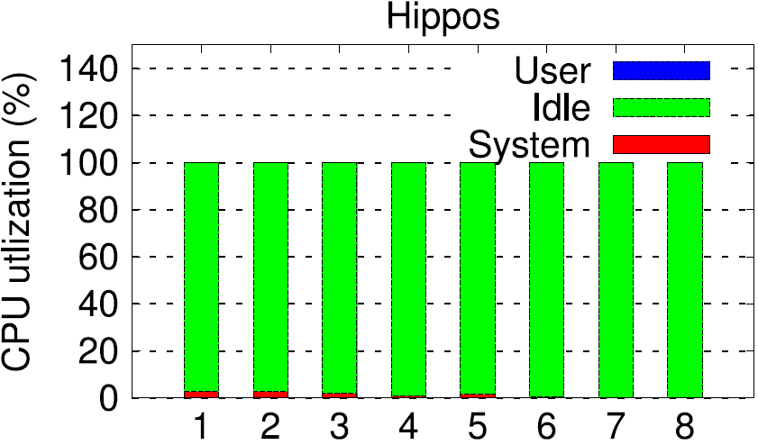
Revisit the Motivation Experiment: Hippos’ Use of Cycles
# of Cores
# of Cores
Notes:
. In addition, the CPU remains mostly idle, opening the door to a substantial energy saving.

Slide 20
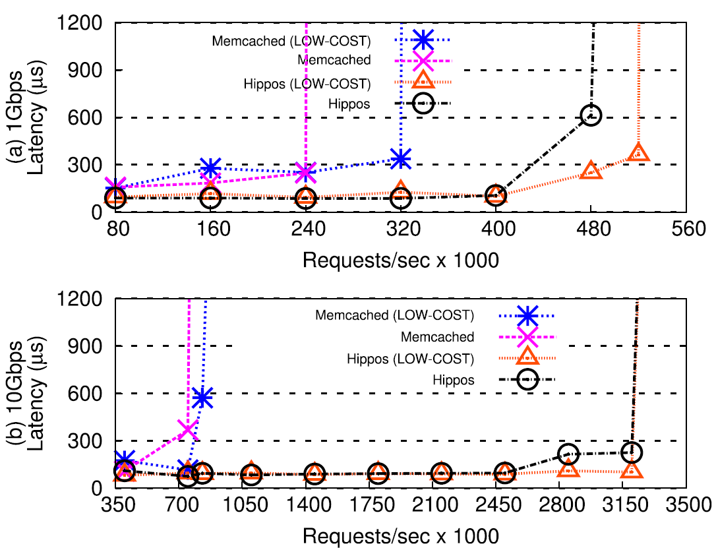
Pushing for the Peak Throughput
Notes:
increasing request arrival rate in a KV store system would increase average request latency until peak throughput is reached and latency grows unacceptably high.
Hippos doubles Memcached’s peak throughput (480 K Req/s vs. 240 K Req/s)
This is because Hippos has already eliminated the cost of lock protection associated with GETs with the use of the RCU lock and the CLOCK replacement
for the 10 Gbps network Hippos has a larger improvement of peak throughput (more than 4×) Hippos shifts the throughput bottleneck from the CPU to the network. Accordingly a 10 Gbps network exposes more of Hippos’s potential.

Slide 21
Characteristics of the Facebook Traces
Request Type Distribution in different Memcached pools
 | USR | ETC | APP | VAR | SYS
GET | 99.7% | 73.4% | 83.4% | 18.0% | 67.5%
SET | 0.2% | 2.3% | 5.2% | 82% | 32.5%
DELETE | 0.1% | 24.0% | 11.4% | N/A | N/A
Request Size (99% percentile size)
 | USR | ETC | APP | VAR | SYS
KEY | 16B/22B | 45B | 80B | 30B | 45B
VALUE | 2B | 450B | 512B | 200B | 640B
Notes:
Facebook’s memcached servers have been placed into the five separate caching pools, accordingly to different applications or data domains they serve.
Most of them are GET-dominant.
Small values and keys dominate GET requests.

Slide 22
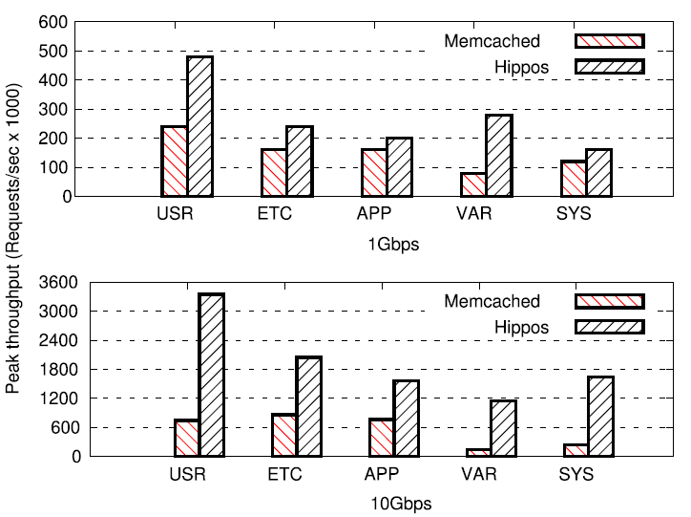
Peak Throughput
1GBps
10GBps
Notes:
The peak throughput is increased by 98%, ETC, APP, and SYS have relatively moderate improvements in the 1 Gbps network they have relatively large values
Hippos to achieve a high increase (2.5×) of peak throughput

Slide 23
Energy Consumption
Notes:
the power savings are less significant between 5% and 20% because TCP-based UPDATEs keep all cores busy and Hippos can hardly use only one
core to serve requests.
the improvement on power consumption is usually consistent across different request rates with with the three request rates Hippos reduces the instruction count by 45%, 53%, and 51%, respectively. These reductions are less correlated to request rate but correlated to power saving. So even for KV store users who see relatively low
request rate and might not be interested in latency improvements as long as the latency is not too high, such as exceeding 1 ms, Hippos can be still appealing with its advantage on power saving across the different request rates.

Slide 24
  Conclusions
User-level KV cache tends to be CPU bound with its performance bottleneck on the network stack.
    Building an in-kernel KV cache as a high-performance and energy-efficient appliance is a viable and promising solution.
Hippos removes the bottlenecks limiting KV-cache’s performance at the network stack and within the cache.
The prototype implementation demonstrates that Hippos can effectively improve system’s throughput and reduce energy consumption.

